Slide 1

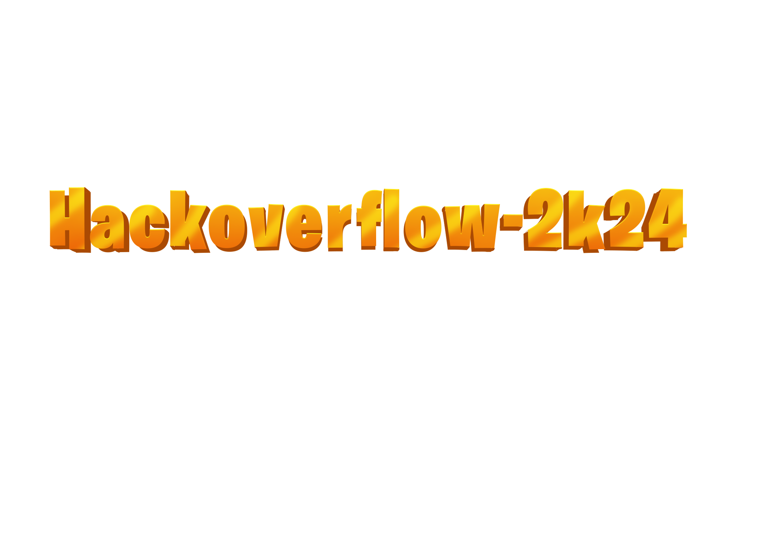

Basic Details of the Team:
Team Name: ERROR 404!
Team Leader Name: Thummu Koushik
Team Leader Mobile Number: 7780753835
Team Leader Email: koushikt33@gmail.com
No of Team Members: 6
Institute Name: S R K R Engineering College
​
1

Slide 2
Domain & Problem Statement:
Domain (Technology):
Healthcare Technology focuses on IoT, AI, and web development.
Problem Statement:
Real-Time Hospital Inventory Management: Build a system that uses IoT sensors and AI to streamline hospital inventory management. This solution will provide real-time visibility of medical supplies, reduce manual effort, and help healthcare workers quickly locate and restock necessary items, improving operational efficiency.
​
2

Slide 3
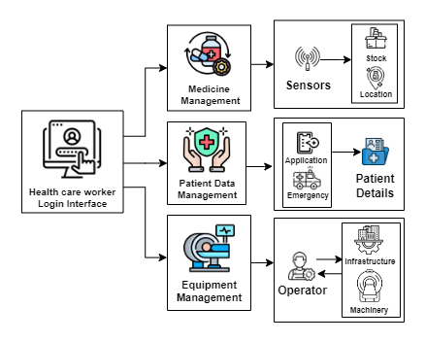
Idea/Approach:
PROCESS FLOW ARCHITECTURE
To develop a responsive, and centralized hospital inventory management platform with real-time tracking, efficient management, and data-driven optimization of medical supplies, equipment, and patient data interfaces.
​
Employ IoT sensors to automate the real-time tracking and management of medical supply inventory, ensuring accurate stock levels and locations.
Securely store and manage patient data, including medical history, current medications, and treatment plans, within a centralized patient information system.
Implement a real-time tracking of equipment locations, availability, and operational status, as reported by operators.
3

Slide 4
Objective & Scope of Solution:
OBJECTIVE
Employ IoT sensors for optimized resource allocation and improved operational efficiency.
Streamline operations by reducing manual tasks and enabling rapid location of supplies.
Optimize equipment usage to maximize efficiency and minimize downtime.
Prioritize patient care through automated processes and streamlined workflows.
SCOPE OF SOLUTION
Automated alerts for stock depletion, nearing expiry dates, and abnormal usage patterns.
Use patient data (e.g., allergies, medical history) to ensure that appropriate supplies are allocated to each patient.
Identify equipment performance issues or malfunctions in real time.
​
4

Slide 5






Potential challenges and risks
Problem - Solution
The accuracy and reliability of IoT sensors can be affected by factors like aging and faulty sensors.
Equipment failures can result in operational disruptions and delays in patient care.
Protecting sensitive patient and inventory data from unauthorized access is a critical concern.
Faulty sensors
Regular inspection
Strategies for tackling challenges
Regularly inspect sensors to identify anomalies and ensure accurate data collection.
Conduct regular maintenance and updates to prevent equipment failures.
Use secure access codes to limit data access and management to authorized staff.
Equipment failure
Daily maintenance
unauthorized access
secured access codes
​

Slide 6

Resources Required:
IoT Sensors :
IR Sensors
RFID Sensor
DHT11
Ultrasonic Sensor
MICROCONTROLLERS :
ESP32
ESP8266(NODE MCU)
Display :
LCD 16 X 2
I2C Module
SOFTWARE :
Arduino IDE
CPP
Frontend:
HTML, CSS
JavaScript
Bootstrap
Database:
MongoDB (Atlas)
Backend:
Node.js
Express.js
Mongoose
Other :
Twilio
​
5

Slide 7
Team Member Details:
Team Leader Name: Thummu Koushik
Branch: CSE Year: II
Team Member 1 Name: Javvadi Phaneendra
Branch: ECE Year: II
Team Member 2 Name: Barnikani Charan Sai
Branch: AIML Year: II
Team Member 3 Name: Sarella Archana
Branch: CSE Year: II
Team Member 4 Name: Uppu Sai Anil
Branch: CSE Year: II
Team Member 5 Name: Vijjarla Naga Pavan Deep
Branch: CSE Year: II
​
6

